Slide 1
ALMA Common Software Basic Track
Introduction to the ACS Framework

Slide 2
The Modern Observatory
Integrated and distributed architecture (end to end data flow)
Archive and virtual observatory integration.
Feedback systems and distributed control loops.
Big projects and small projects: what are the differences?
Notes:
A modern Observatory (or any other experimental facility) has a complex integrated and distributed architecture.
In the past, the Astronomer (the main stakeholder for our systems) was traveling to the Observatory, making his observations, storing data on tape and going back home to reduce it.
The telescope and, eventually, the instruments had a control system virtually independent from everything else.
Data reduction was done offline after the observation and there was no direct feedback from the observation data to the control system. An experienced observer was just driving the telescope based on his own feelings.
There was no observation data archive, no quality of service measures and constraints, no facility engineering in the terms we think of now.
This has dramatically changed in the past 20 years, with the big observatories like VLT, Keck, Gemini, Hubble and so on.
Since the major observatories are now providing integrated facilities, astronomers expect the same also from smaller ones and the amount of integration required for the new projects like ALMA and the giant optical telescopes like E-ELT, TMT or GMT will be even more. The Virtual Observatory is also contributing to this need for integration and quality control adding the intra-observatory dimension to the problem.
Now all the systems in an Observatory are fully integrated.
Observation data, weather and telemetry are directly fed back in the control system to obtain optimized performance.
The astronomer is in many cases not even any more going to the observatory, but monitors the observation from his own institute and can ideally interact with the system remotely when the observation is taking place.
The astronomer expects to interact with the system using “standard” Web technology.
Data is archived to be usable by Virtual Observatories and therefore has to contain calibration and quality information.
Engineers and people responsible for the administration and maintenance of the observatory are another important stakeholder. More and more performance is measured and telemetry information is analyzed daily to perform preventive maintenance and optimize the system or to measure performance trends over long time periods.
The new systems being designed now (like the ELTs) will need to coordinate the real time operation of devices distributed over large distances (hundreds of meters or even more). This is raising distributed control challenges to the next level.
Big projects are driving this evolution, but also small projects have to follow up in this direction to match the expectations of the observers. For them, the reduced budget makes it unaffordable to develop in-house integrated solutions. Many small projects are therefore interested in adopting solutions developed by other, bigger, ones.

Slide 3
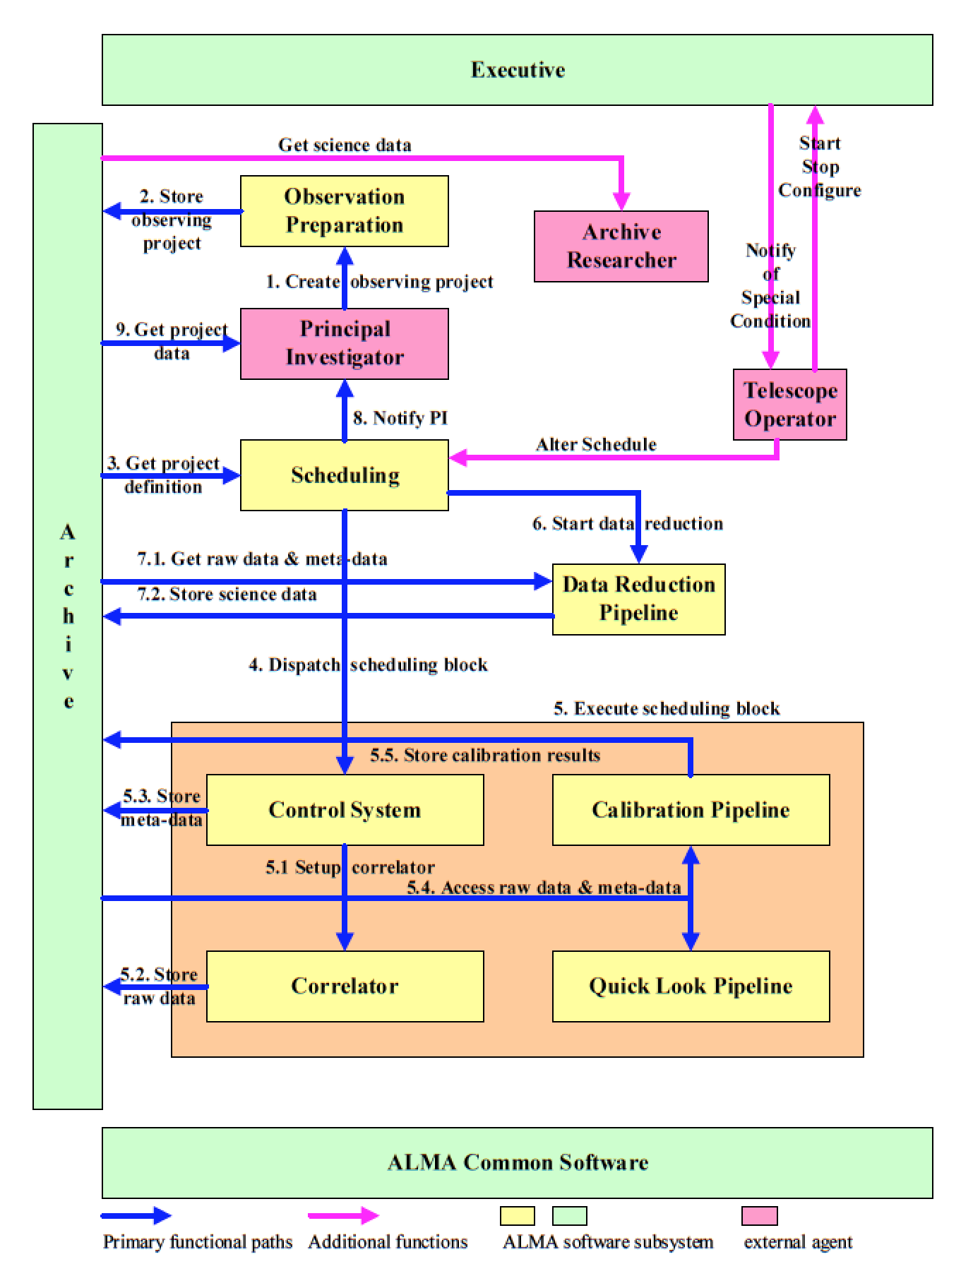
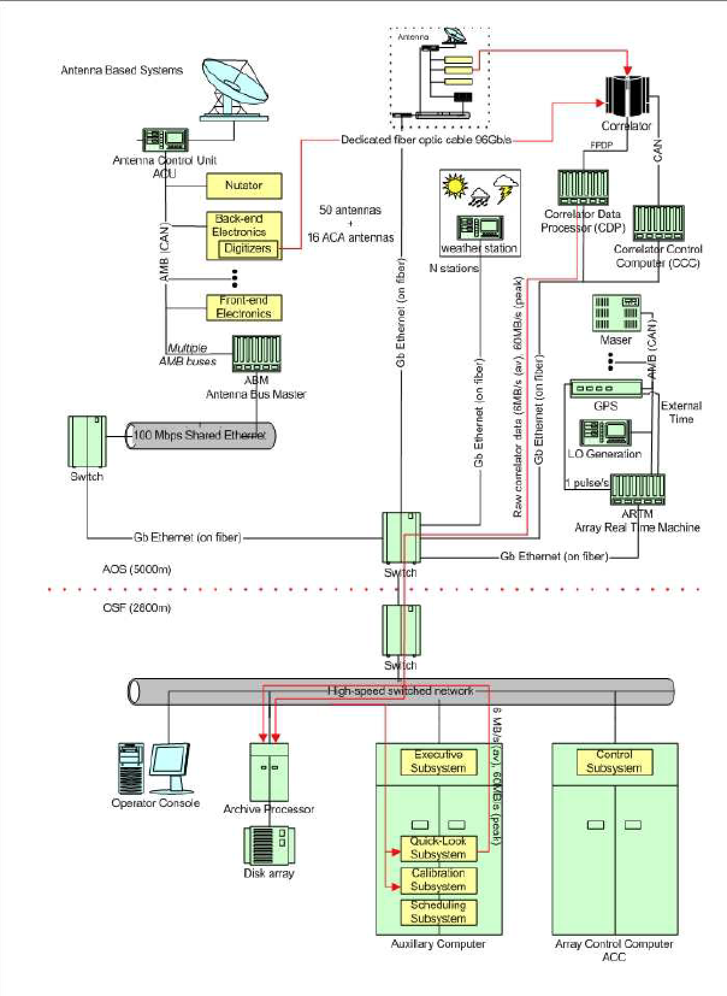
Example: ALMA Software and Physical Architecture
Notes:
Let’s take as an example a schematic architecture of the ALMA software (A.Farris, J.Schwarz ALMA HLA team).
This diagram shows the main subsystems in which the software has been divided and the main relationships among then in the form of a collaboration diagram describing the typical lifecycle of a project, starting with proposal submission and ending with a researcher looking for the data in the archive after the observation has been performed.

Slide 4
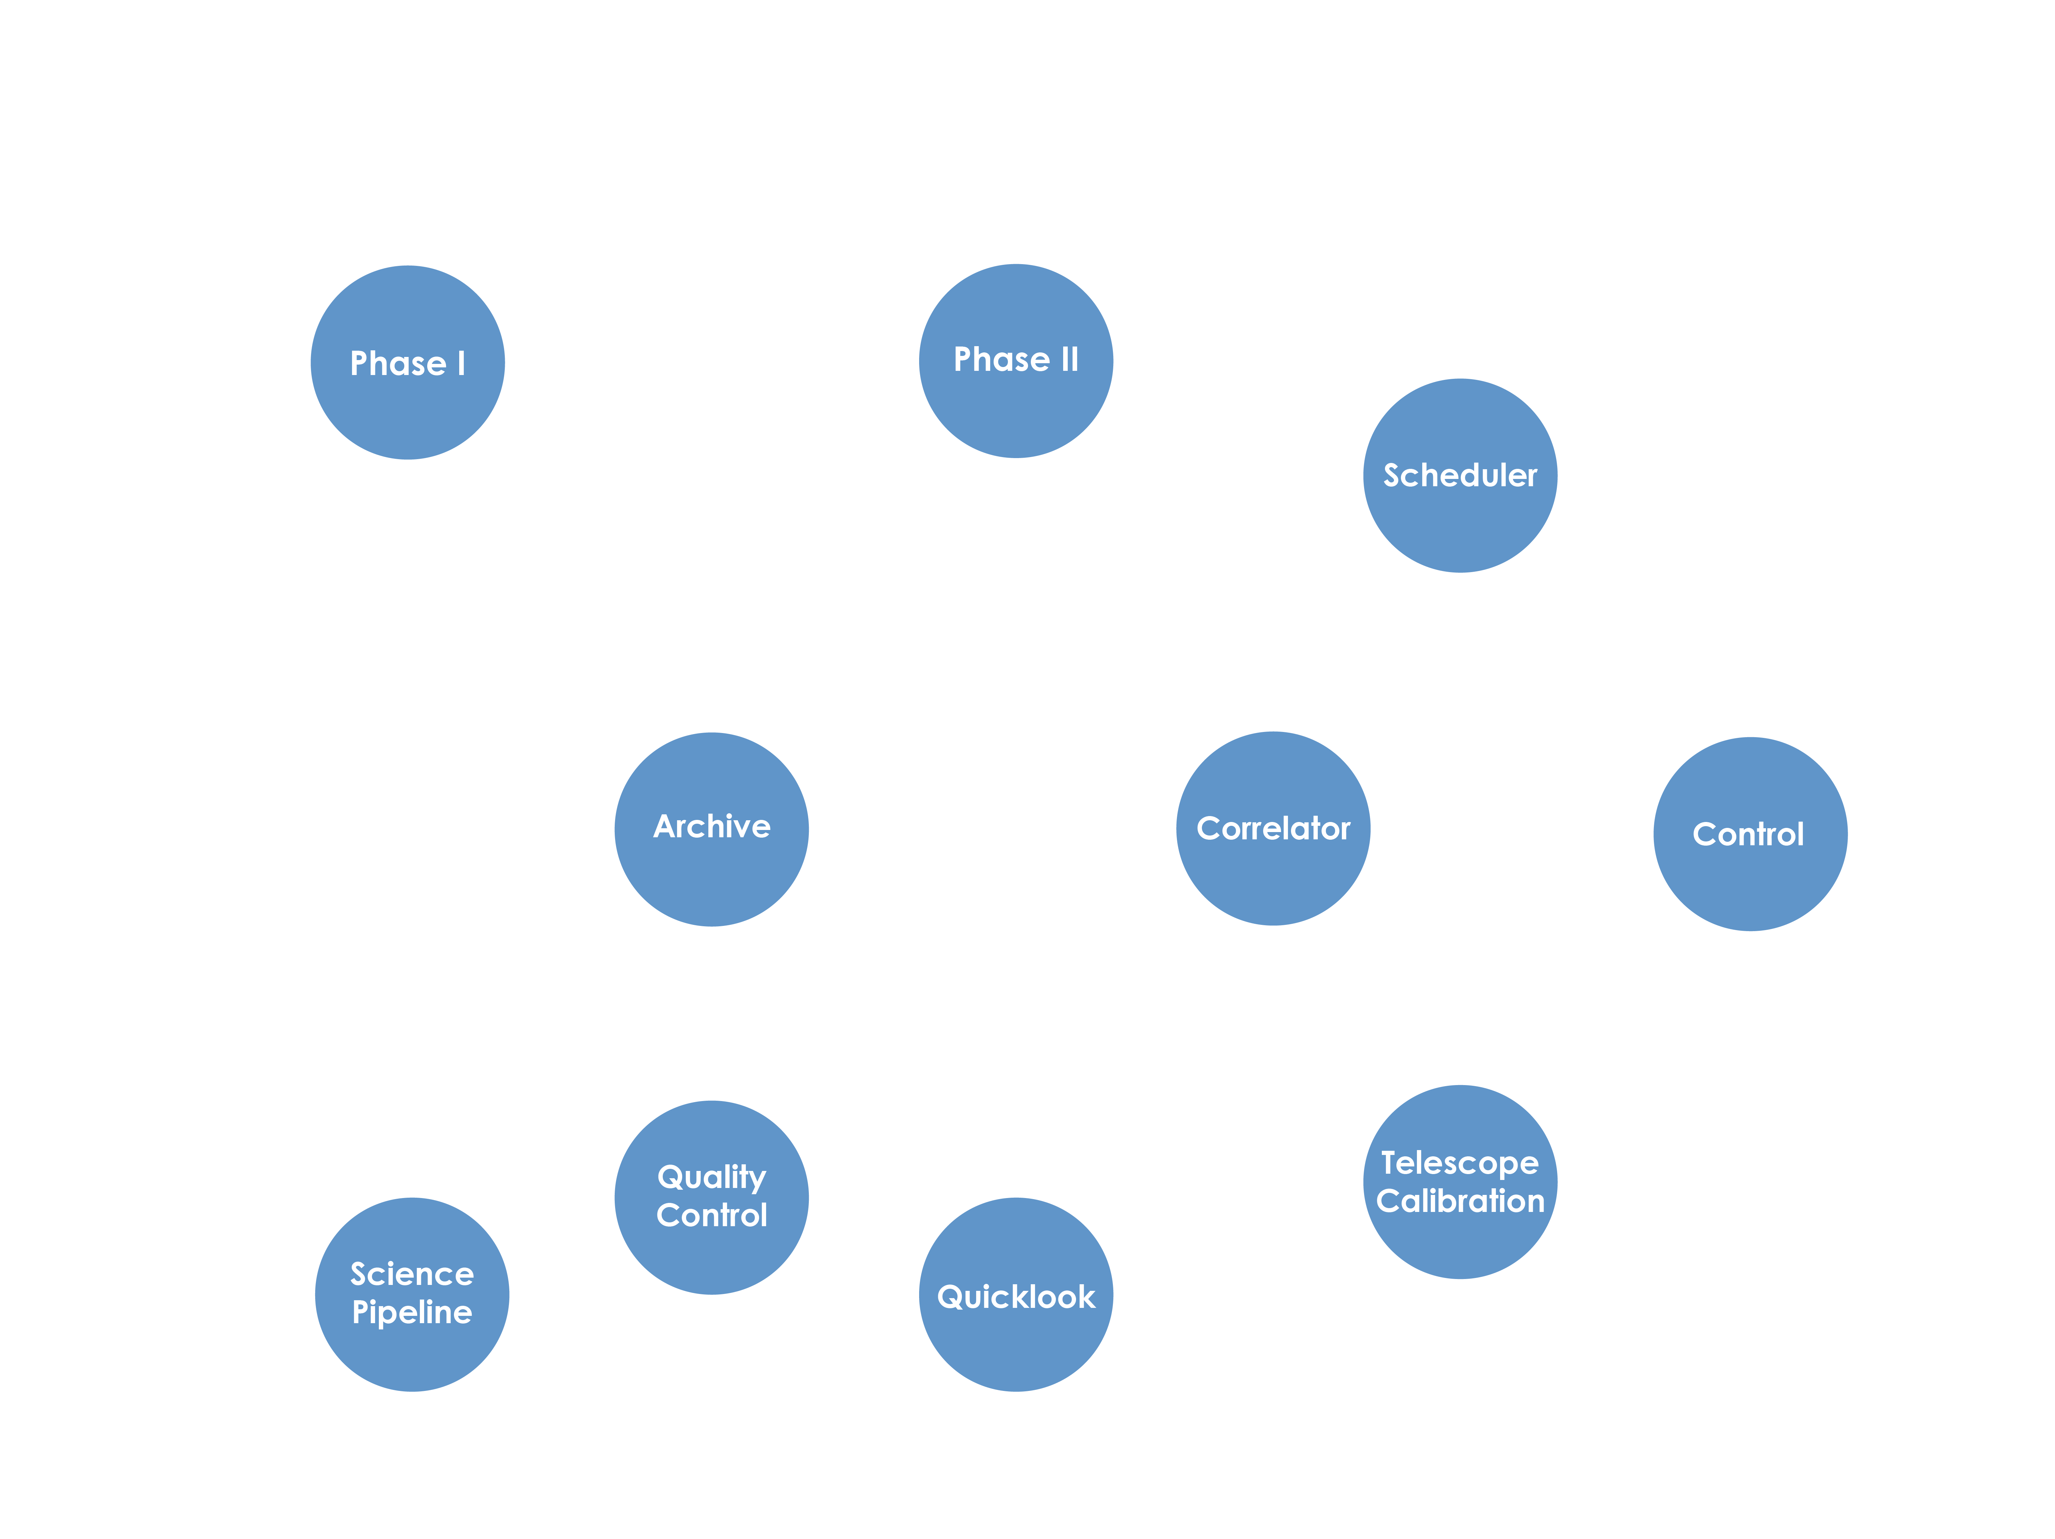
Example: ALMA Data Flow
Notes:
Let’s take as an example a schematic architecture of the ALMA software (A.Farris, J.Schwarz ALMA HLA team).
This diagram shows the main subsystems in which the software has been divided and the main relationships among then in the form of a collaboration diagram describing the typical lifecycle of a project, starting with proposal submission and ending with a researcher looking for the data in the archive after the observation has been performed.

Slide 5
Distributed System
Requirement: the observatory is a distributed system.
Servers and clients are distributed on different machines:
Possibly in different locations
With different purpose and functionality
With different requirements on performance and reliability
This leads to a…
Notes:
As can be seen from the previous discussion, the architecture of the observatory is very distributed.
Servers and clients need to be distributed in different locations inside and outside the physical observatory where the telescope resides.
The different parts of the system (that we did not better specify yet) have different purpose and functionality and therefore have different requirements on performance and reliability.
If we take into account that parts of the system are dedicated to real time control of hardware, coordination, database management, data analysis up to the GUIs on the astronomer’s desktop, we see that this distribution involves something more than a plain Distributed System.

Slide 6
Heterogeneous Distributed System
Requirement: the observatory shall be a heterogeneous distributed system.
Servers and clients may use different:
Hardware
System software
Programming languages
Notes:
What we really have is a Heterogeneous Distributed Systems, since the distribution involves different:
Hardware platforms and architectures. From real time computers to PCs of any kind on the desktops, we can have very different hardware architectures (CPU, word size, alignment, memory available…)
System software. Any of these machines can have a real time operating system, Linux or other variants of Unix, Microsoft operating systems, MacOS or even more exotic software platforms like PalmOS
Programming Languages. Different programming languages are more suitable for different application domains. For example, C and C++ are most suitable for real time and CPU intensive applications, while Java fits well in coordination, high level or GUI developments. Astronomers will want to write their observation scripts and reduction procedures in high level scripting languages.

Slide 7
Transparent Heterogeneous Distribution
Developers of clients should be unaware of the underlying server architecture & vice-versa
It should be possible to change the architecture of a server transparently to the client
Client developers should not even need to know whether a server is local or remote.
Notes:
In order to achieve the “separation of concerns” objective, applications developers have to be unaware of the architecture (hardware, software, programming language, location) of the servers they interact with.
Having to deal explicitly with network communication protocols, byte order of message data, connection reliability and similar problem would be a major burden on the shoulders of the application developer.
The technical framework has to take up this responsibility and hide all these problems to the functional developers.
It shall even be possible to fully replace the server with a different one without the client noticing.
We could (and this has been often the case in past projects) keep the heterogeneous domains separate. For example data analysis and control system could be implemented using different and independent software infrastructures, but this approach will lead to many problems in the interfaces. In the past, interfaces were limited and this was not an important issue. But the level of integration needed nowadays makes such a choice highly problematic.
The infrastructure Framework has to take care of these aspects of the system.

Slide 8
Functional and Technical Architecture
The separation of functional from technical concerns is a strategy for enabling the application developer to concentrate on the specific aspects of the observatory
Expressing the complexity in software of an observatory is difficult
Having to know the subfields of computer science associated with distributed object architecture is also very challenging
Conclusion
Let system developers take care of the computer science-related tasks
Notes:
Expressing the complexity in software of operating a mm-wavelength interferometer is difficult enough for the
developer without the additional burden of having to know in detail the all the subfields of computer science
associated with distributed object architecture, such as remote access, network protocols, and database technology.
The separation of functional from technical concerns is a strategy for enabling the application developer
to concentrate on the physics, algorithms, and hardware details of aperture synthesis interferometry, while a
specialized, system-oriented team provides an easy-to-use technical infrastructure.
The functional architecture further apportions these interferometry-related tasks among subsystems that can
be developed in relative independence from each other.
The technical architecture furnishes developers of these
subsystems with simple and standard ways to 1) access remote resources; 2) store and retrieve data; 3) manage
security needs; and 4) communicate asynchronously with other subsystems and components.

Slide 9
Functional Architecture
A Functional Software Architecture (FSA) is a model that identifies enterprise functions, interactions and corresponding information technology needs.
Software components/subsystems
Responsibilities
Interfaces
Primary relationships and interactions
Physics and algorithms
Hardware deployment and distribution
It is developed by architect and subsystem leaders
Notes:
The functional architecture is built based on the user requirements.
The functionality that needs to be implemented is assigned to components/subsystems and the architecture describes the responsibilities of each subsystem and the interfaces that are exposed to the other subsystems or to the external world.
Then the relationships between the subsystems (i.e. how these interfaces are used when asking reciprocally services) are described.
The functionality must be implemented according to the physics of the system and must implement specific algorithms that must be described in this architecture. For example scheduling algorithms, control algorithms, data reduction strategies are all part of the functional architecture.
Another essential driving factor is the actual deployment and distribution of the hardware that must be controlled by the software. For example, the physical deployment of motors and sensors and the physical connection of the electronics to the control computers affects the functional architecture of the system. Or the location of the data archives and of the CPU factories for data reduction.

Slide 10
Technical Architecture
The functional architecture must be supported by a technical architecture that describes (and implements) the technical aspects of the software
Access remote resources
Store and retrieve data (Database technology)
Manage security needs
Communication mechanisms and networking
Software deployment and activation
Programming model
It is provided by the technical team
Notes:
The “functional architecture” must be supported by a “technical architecture” that describes (and implements) the technical aspects of the software, like the communication protocols used, the threading model, the software deployment (process handling, distribution, activation and deactivation).
The requirements for the technical architecture are mostly derived requirements.
While the user requirements are the basis for the development of the functional architecture, we derive most of the technical requirements from the functional architecture itself: the technical architecture shall enable us to implement the functional architecture.

Slide 11
Separation of concerns
Functional and technical architecture: two views
Subsystem teams should concentrate on function
Technical architecture provides them with simple and standard ways to, for example:
Access remote resources
Store and retrieve data
Manage security needs
Keep the two concerns separate!
Notes:
Functional and technical architecture are two different views of the system.
Subsystem developers should concentrate on the functional aspects of the system, i.e. in the implementation of the physics and algorithms.
They have to be freed from the need of designing and implementing mechanisms for interfacing, communicating, deploying or handling security.
The detailed design of the Technical architecture must be mastered by infrastructure developers.
Application developers are required to understand just the concepts of both the technical and functional architecture.

Slide 12
Infrastructure Framework
The key to the separation between Functional and Technical Architecture
Purpose of a framework is to:
provide a programming model
Ensure that the same thing is done in the same way in all the development locations
provide common paradigm abstractions
mask heterogeneity
satisfy performance, reliability and security requirements
Notes:
The key to reach this objective is to adopt a Software Framework that provides a consistent infrastructure for the whole observatory. On one side the framework has to satisfy all the requirements of performance, reliability and security derived from the functional architecture. On the other side it must hide as much as possible its own internal complexity to the subsystem developers and provide them with a clear and streamlined programming model.
What can be a definition of software framework?
The current definition from the Wikipedia (http://en.wikipedia.org/wiki/Software_framework) is:
------------
A software framework is "the skeleton of an application that can be customized by an application developer”. Like software libraries, it aids the software developer by containing source code that solves problems for a given domain and provides a simple API. However, while a code library acts like a servant to other programs, software frameworks reverse the master-servant relationship. This reversal, called “inversion of control”, is the essence of software frameworks.
Frameworks are designed with the intent of facilitating software development, by allowing designers and programmers to spend more time on meeting software requirements rather than dealing with the more tedious low level details of providing a working system. However, there are common complaints that using frameworks adds to “code bloat”, and that a result of competing and complementary frameworks is that one trades time spent on programming and design for time spent on learning frameworks. Having a good framework in place allows the developers to spend more time concentrating on the business-specific problem at hand rather than on the plumbing code behind it. Also a framework will limit the choices during development, so it increases productivity, specifically in big and complex systems.
------------
However you can find many definitions pushing more of less on certain aspects of the concept of framework and even the definition in the Wikipedia has been quite volatile.
The E-ELT project has written a Technical Requirements document for the TCS Software Framework. This document is used for the evaluation of the different alternatives. This document states that:
------------
The role of the Software Framework product is to allow the control software applications to communicate in this distributed environment and to enforce a coherent integrated system. The Framework hides the operating systems from the application, provides common services and provides an API. The Framework may or may not include dedicated tools to generate applications, e.g. code generators, so called Application Framework. It is emphasized that the priority in this document is on the support structure.
The justification of using a Framework is to make application development easier, by providing common programming abstractions, by masking heterogeneity and the distribution of the underlying hardware and operating systems, and by hiding low-level programming details. The advantages of using a Framework come with potential caveats. These shall be taken into account when selecting and/or developing a Framework.
------------
We will examine some of the requirements for such a framework in our domain and what options are available.

Slide 13
The ALMA Common Software (ACS) Framework
ACS provides the basic services needed for object oriented distributed computing. Among these:
Transparent remote object invocation
Object deployment and location based on a container/component model
Distributed error and alarm handling
Distributed logging
Distributed events
The ACS framework is based on CORBA and built on top of free CORBA implementations.
Model driven development with code generation
Notes:
ACS provides the basic services needed for object oriented distributed computing using different programming languages. Among these are:
Transparent remote object invocation
Object deployment and location based on a container/component model
Distributed error and alarm handling
Distributed logging
Distributed events
The ACS framework is based on CORBA and built on top of free CORBA implementations.
Free software is extensively used wherever possible, to avoid “re-inventing the wheel”.
ACS itself is publicly available under the Lesser GNU Public License (LGPL) license 8
ACS’s primary platform is Red-Hat Enterprise Linux, but it works and is used also on other Linux variants.
Real time development is supported on Real Time Linux (for ALMA) and VxWorks (for other projects).
Development is supported in C++, Java and Python. Any other language with a CORBA mapping can be used, if needed. Coherent support of multiple programming languages is one of the key motivations for the implementation of ACS.

Slide 14
Supported Platforms
Operating system: RHEL 5.5 and 6.5 (32 and 64 bits)
CentOS/SL 5 and 6 binary compatible
Other linux versions supported by external projects
Windows added also by external initiatives
Real-time: RTAI
VxWorks supported by and for APEX
Languages: C++, Java, Python
CORBA middleware: TAO (C++), JacORB (Java), Omniorb (Python), CORBA services.
Embedded ACS Container: PC104, Debian, 300Mhz Geode, 256MB RAM, 256 MB flash (CosyLAB microIOC), …
Notes:
The platforms and development environments supported by ACS are decided for each release, based on the requests coming from the user’s base.
Our main development platform is Linux, while real time systems run under RTAI and VxWorks.
For example ACS 5.0 will provide official support for:
Linux (RH Enterprise and Scientific Linux 4) development and run time
RTAI (Linux Kernel version 2.6.10, RTAI 3.2)
Cross development for VxWorks (Tornado 2.5) from Linux, upload on VxWorks run time and debugging
Future releases of ACS will also support small-footprint run time only installations.
An MS-Windows version of most ACS core components is used at JSI for development and testing.
Other platforms are supported by external groups.

Slide 15
LGPL and open source software
The strategy to provide common features to users is:
Use as much as possible open-source tools, instead of implementing things.
Do not reinvent the wheel
Reuse experience of other projects
Do not pay for licenses
Support from user community
Identify the best way to perform a task among the possibilities
Wrap with convenience and unifying APIs
ACS is distributed under the LGPL license
Open source software may have drawbacks:
Fast lifecycle and support only of the newest
Free/commercial support
Documentation not as good as commercial products
Notes:
One of the first key decisions for the development of the ALMA software has been the one of embracing the free-software philosophy.
The problems we face in the design of our system are similar to the problems encountered by other projects,
The adoption of commercial packages ties one to specific vendors, often with license costs that would be prohibitive for the budget of our project and with the high risk of being affected by changes in the commercial strategy of the vendor.
Therefore we decided to build our software infrastructure by taking advantage of the experience of other projects, using as much as possible freely available and at the same time widely used software.
A wide open software community promises also good and fast support through the usage of newsgroups and discussion forums. Open community forums are very active and replies come very often within a few hours.
The lifecycle of open software is very fast and there is no or little support for older versions. When a bug is identified, the fix usually arrives very quickly, but it is almost always tied to the latest, "bleeding-edge" version of the software. Patches to previous versions are rare. Accepting the fix thus often means accepting new features, backward incompatibilities and, perhaps, new bugs. The alternative is patching the old code ourselves (this is possible since the source code is freely available).
When an open software product really becomes mainstream the resources that the authors would have to put in support become quite substantial. We have seen that very often at this point a company is founded to provide support and consultancy as a way to pay the costs. This corresponds normally to a sharp decline in the contribution of the core authors to the newsgroups, in order to convince the users to purchase support from the company.
Documentation for free software is very different from the documentation you normally expect from commercial products. First of all it is very different from package to package. Detailed and comprehensive user and reference manuals are typically absent. Very often we end up having to look inside the source code.
We have seen for example, that the costs during the past year for keeping pace with real-time Linux releases and having a stable system have been much higher than originally foreseen. We have been often forced to take versions of the real-time Linux development software that is "hot off the press," just to get basic features running, although reported problems have been fixed quite promptly.

Slide 16
Separation of roles
ACS keeps separate 3 roles/phases:
Development by software developers
Deployment by deployment engineers
Runtime by system operators

Slide 17
Development
Developers write components and graphical user interfaces clients in C++, Java, or Python.
ACS provides an integrated build environment based on application code modules.
Communication from an application to a component, and among components, uses ACS as middleware.
No thinking about starting and stopping components, or on which machine they should run later.
Notes:
Most ALMA software is written as Components, which have no GUI.
The concept of Container / Component will be explained in separate presentations.
Mainly the scientists (writing Observation Projects or researching the archive), as well as the ALMA operators, will see GUI clients. These are written by the ALMA subsystems ObsPrep, Exec, Pipeline/QuickLook, and Archive. ACS provides an optional GUI framework called “Abeans” which is particularly aimed at writing control applications GUIs. We will not touch on GUIs in the ACS course though.
ACS allows to easily write distributed applications. The application developer has to write software that conforms to the standards. The reward is an application that can later run on one or many machines, without coding overhead for remote communication or starting and stopping the system.

Slide 18
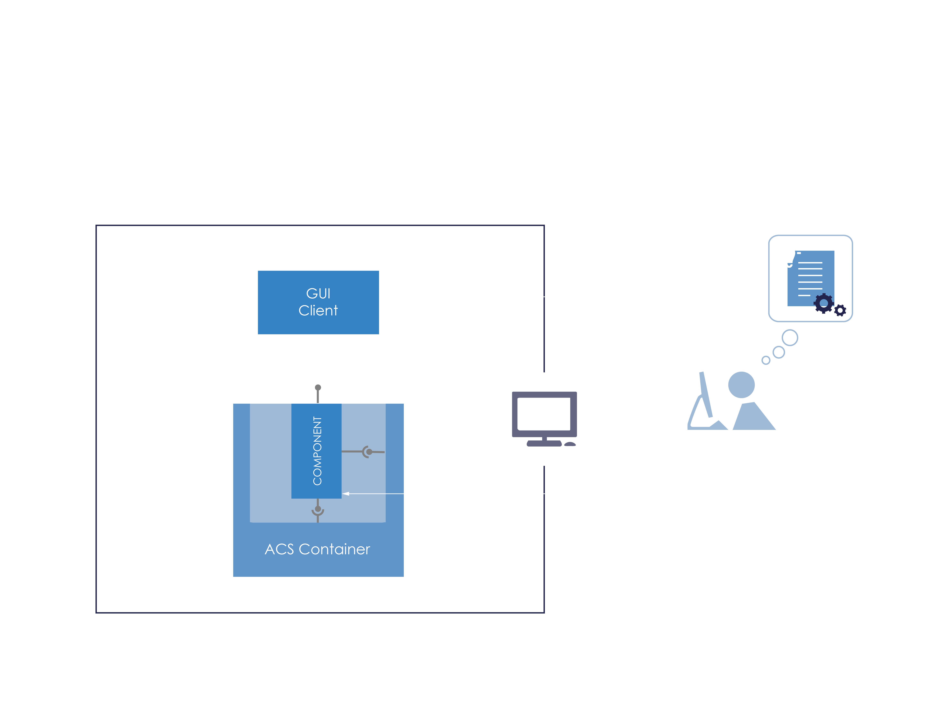
Development
Notes:
Most ALMA software is written as Components, which have no GUI.
The concept of Container / Component will be explained in separate presentations.
Mainly the scientists (writing Observation Projects or researching the archive), as well as the ALMA operators, will see GUI clients. These are written by the ALMA subsystems ObsPrep, Exec, Pipeline/QuickLook, and Archive. ACS provides an optional GUI framework called “Abeans” which is particularly aimed at writing control applications GUIs. We will not touch on GUIs in the ACS course though.
ACS allows to easily write distributed applications. The application developer has to write software that conforms to the standards. The reward is an application that can later run on one or many machines, without coding overhead for remote communication or starting and stopping the system.

Slide 19
Deployment
One or more containers get assigned to each computer.
Components get assigned to containers.
This location information is stored centrally in the Configuration Database (CDB).
Other configuration data for containers and components are also stored in the CDB.
There can be different deployments for unit tests, system tests, and various stages of the production system.
Notes:
Details on container location information and container startup:
for the system to work, it is good enough to start containers by hand on any machine. They dynamically add themselves. This is only done for tests though.
In the real ALMA, the central starter application “Executive” starts containers on various machines
either based on a custom configuration file that assigns containers to machines,
or based on container-machine location data from the CDB from which the manager can start containers.

Slide 20
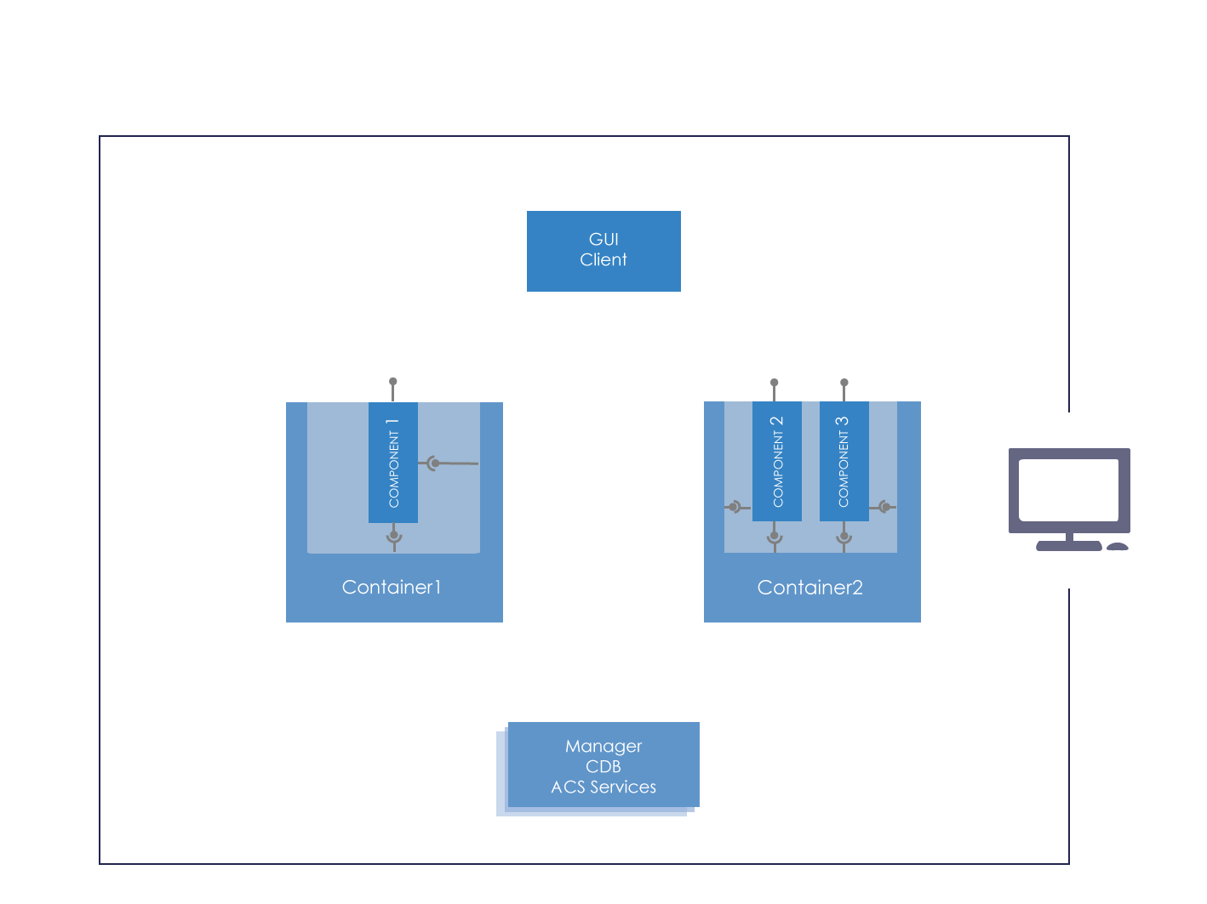
Deployment
Notes:
Details on container location information and container startup:
for the system to work, it is good enough to start containers by hand on any machine. They dynamically add themselves. This is only done for tests though.
In the real ALMA, the central starter application “Executive” starts containers on various machines
either based on a custom configuration file that assigns containers to machines,
or based on container-machine location data from the CDB from which the manager can start containers.

Slide 21
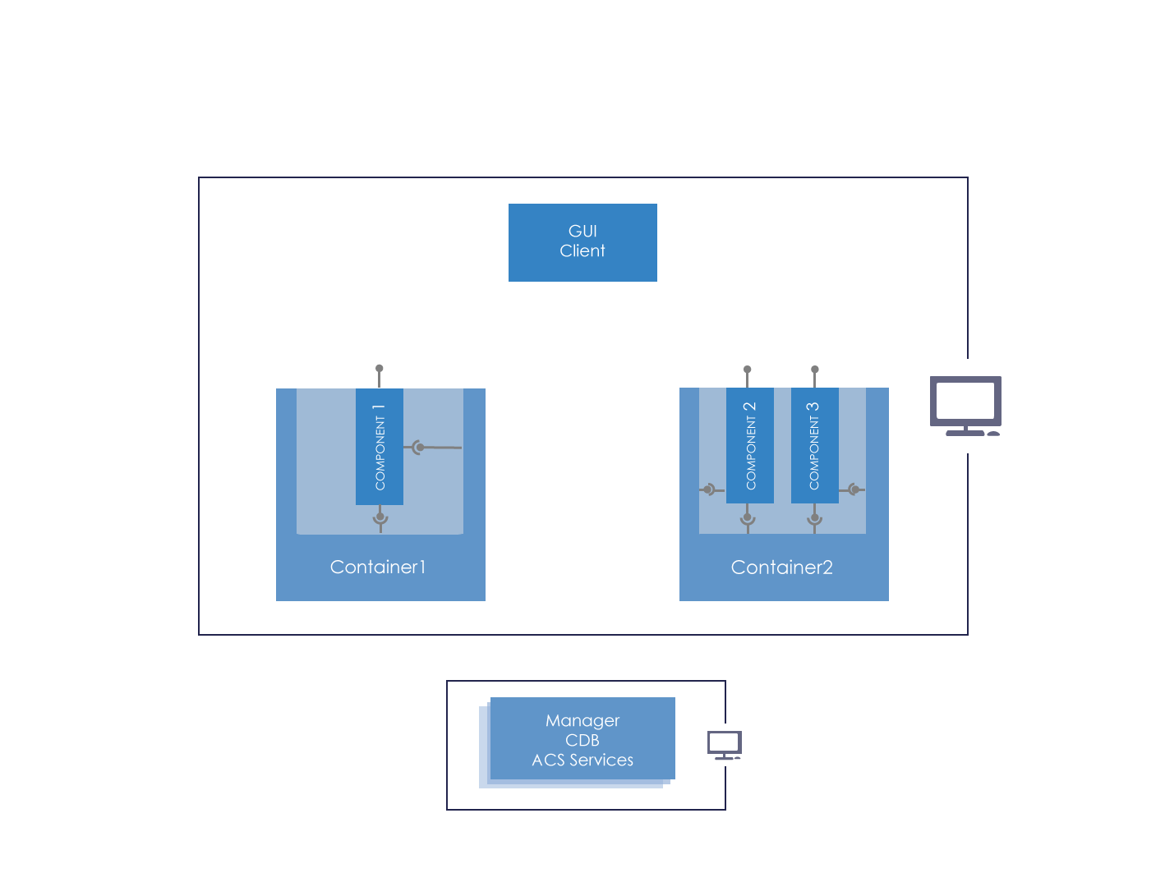
Deployment
Notes:
Details on container location information and container startup:
for the system to work, it is good enough to start containers by hand on any machine. They dynamically add themselves. This is only done for tests though.
In the real ALMA, the central starter application “Executive” starts containers on various machines
either based on a custom configuration file that assigns containers to machines,
or based on container-machine location data from the CDB from which the manager can start containers.

Slide 22
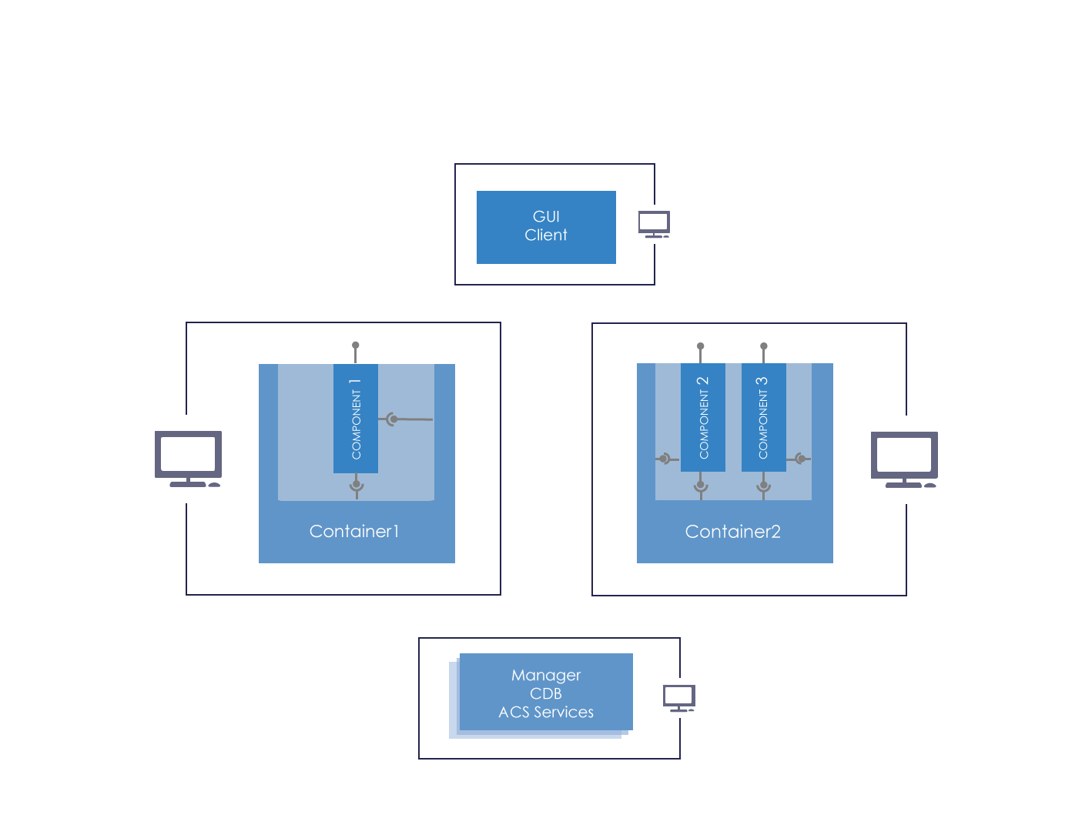
Deployment
Notes:
Details on container location information and container startup:
for the system to work, it is good enough to start containers by hand on any machine. They dynamically add themselves. This is only done for tests though.
In the real ALMA, the central starter application “Executive” starts containers on various machines
either based on a custom configuration file that assigns containers to machines,
or based on container-machine location data from the CDB from which the manager can start containers.

Slide 23
Runtime
ACS containers start and stop components (lifecycle management) as needed.
Containers provide components and clients with references to other components.
The Manager is the central intelligence point that keeps the system together. Components never see it directly.
Manager, CDB, and other services, are started with the “acsStart” command or with the ACS command center GUI.
Notes:
Details on container location information and container startup:
for the system to work, it is good enough to start containers by hand on any machine. They dynamically add themselves. This is only done for tests though.
In the real ALMA, the central starter application “Executive” starts containers on various machines, before any application software gets run. Exec maintains a configuration file that assigns containers to machines.
Soon the CDB will optionally include container-machine location data.
Services:
Error propagation across processes
Logging
Alarm
Event-based notification
Bulk data transfer
Other services can be plugged into the container framework if necessary (e.g. security)

Slide 24
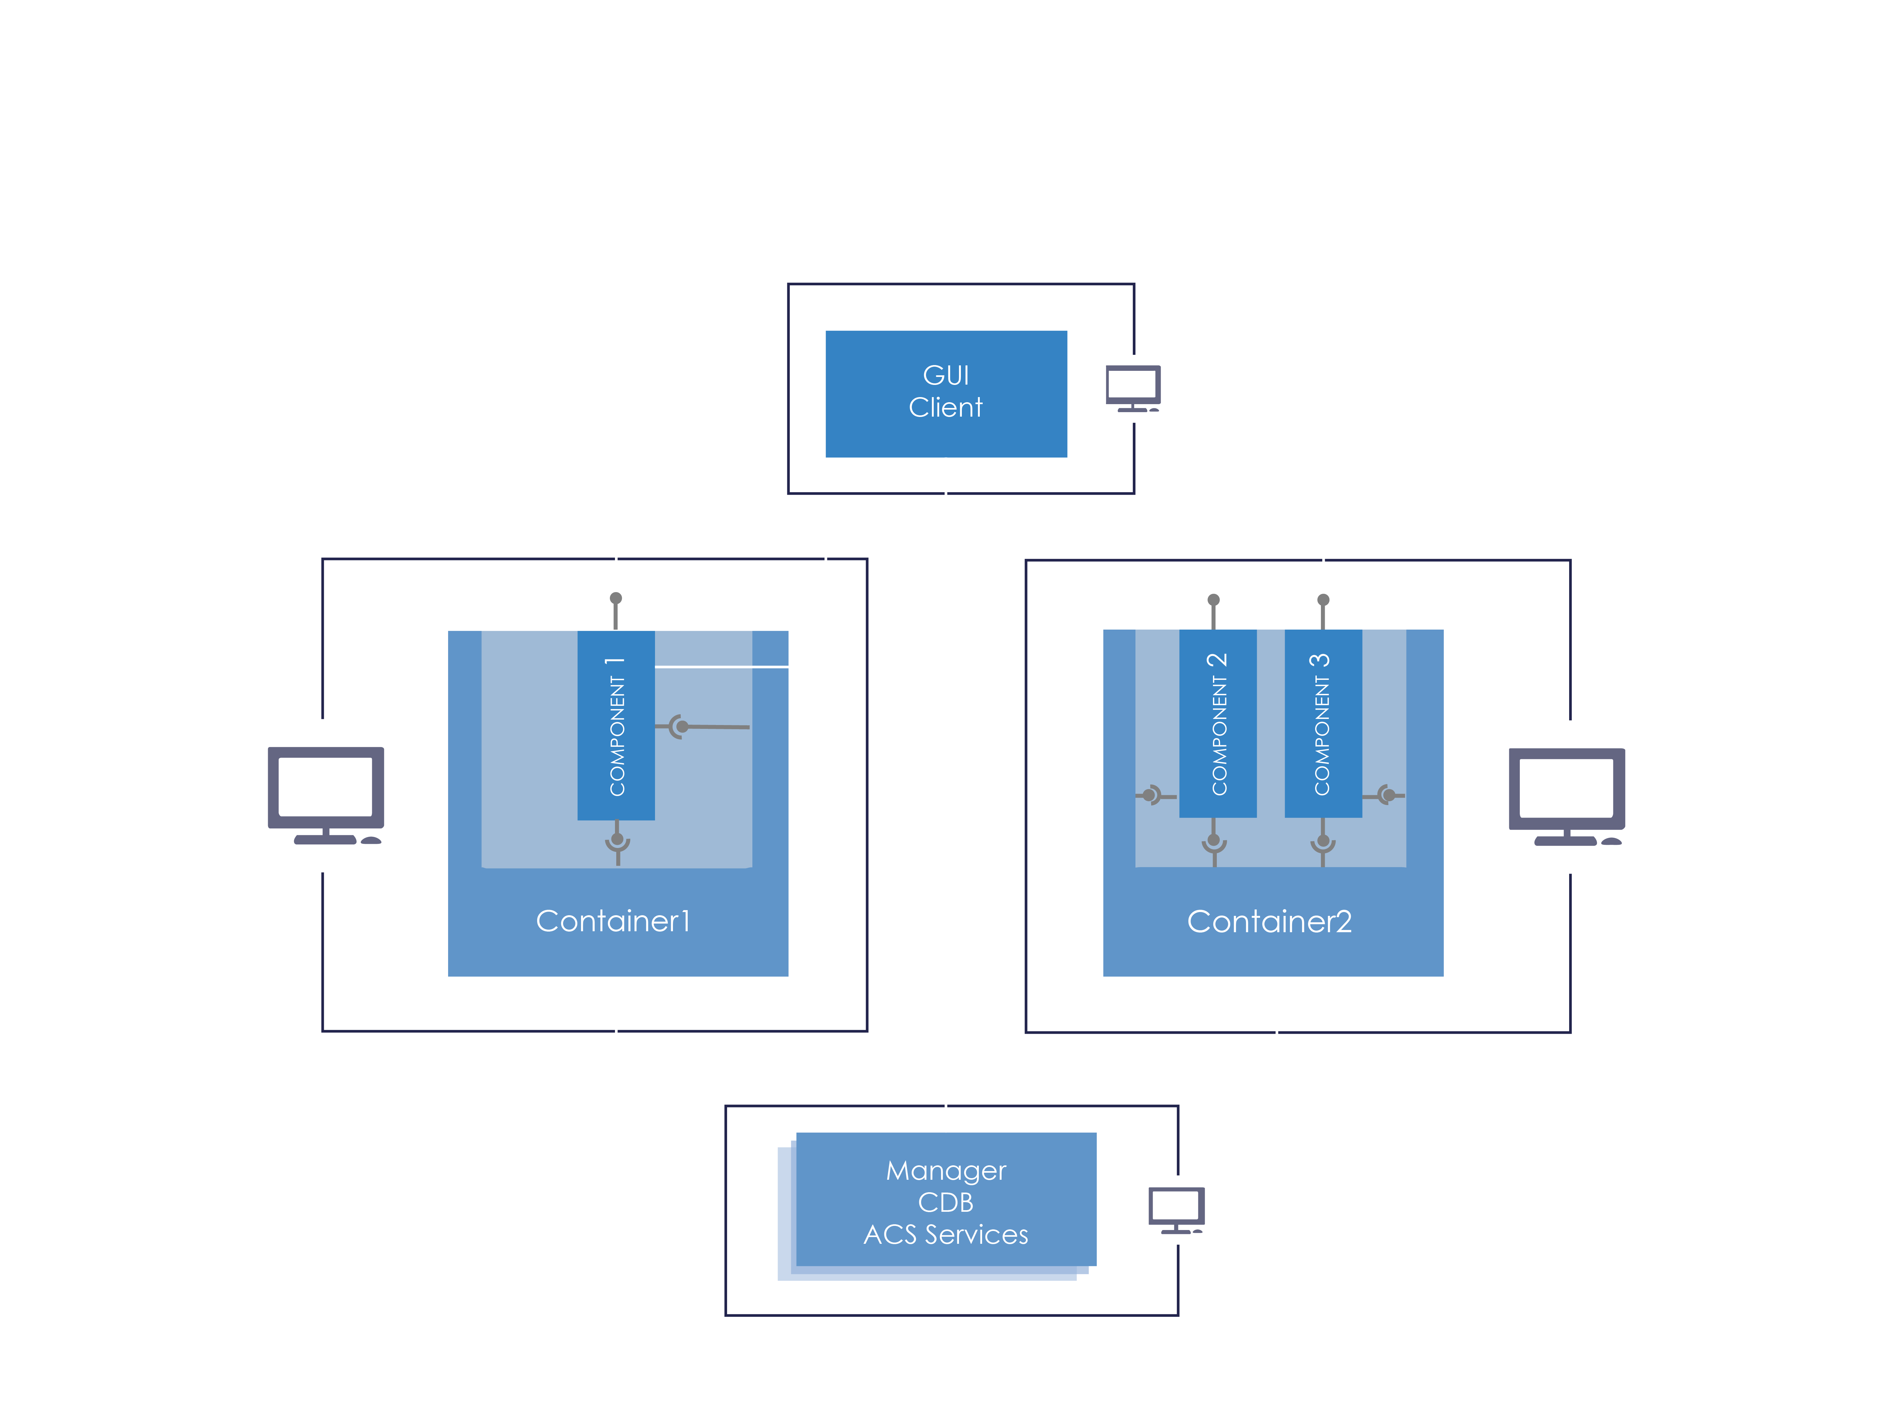
Runtime
Notes:
Details on container location information and container startup:
for the system to work, it is good enough to start containers by hand on any machine. They dynamically add themselves. This is only done for tests though.
In the real ALMA, the central starter application “Executive” starts containers on various machines, before any application software gets run. Exec maintains a configuration file that assigns containers to machines.
Soon the CDB will optionally include container-machine location data.
Services:
Error propagation across processes
Logging
Alarm
Event-based notification
Bulk data transfer
Other services can be plugged into the container framework if necessary (e.g. security)

Slide 25
Interfaces versus Implementations
First step: Identify objects
Mount
Camera
Telescope
Observation
Exposure
Second step: Define interfaces
Implementation comes later and is independent of interface
Deployment is also independent of interface definitions
Interfaces shall be kept as stable as possible, but it must be possible to have them evolve when needed.
A formal interface definition language is needed
Notes:
The contract between the components is specified by clearly defining interfaces.
As a first step in the analysis and design of the system we have to identify the objects that will interact together.
Typically this will be done in layers.
Per each subsystem we will identify the outer layer of objects that will be used in the interactions between subsystems.
Going deeper in the analysis we will identify recursively internal layers of objects.
Once the objects have been identified, we will have to define their interfaces.
At this point we should not care about implementation and deployment.
It shall be possible to implement the interfaces later on using different programming languages and different architectures, as well as deploying the implementation in different ways.
The absolute separation between interface and implementation is essential to interoperability and scalability.
The best way to define interfaces if by using an implementation neutral but formal interface definition language that will be mapped in the implementation languages later on. Using a formal language is very important to avoid surprises and inconsistencies when integrating subsystems developed by different teams. Using just a textual Interface Control Document (ICD) can very easily lead to problems.
The clients of an object know and see only its interface and the interface shields completely the implementation underneath.
This makes it possible first of all to implement a servant in any language.
But it also means that it is possible:
To have different implementations for the same interface, if needed in multiple languages. For example one could provide a mock up implementation in Python for testing and an high performance servant in C++ for the final real time system.
To have one implementation serve multiple interfaces. For example, access to a legacy system could be done defining the interfaces for each subsystem but implementing only one generic servant (for example a sort of protocol converter) able to implement all of them. Another example is a CORBA interface to access an object (or also relational) database. It is not necessary to provide the implementation for each object type (or table) in the database. One single implementation is able to “incarnate” dynamically all interfaces.
To have one physical instance of a Servant to represent multiple logical instances. Or the other way around. Or any intermediate situation, based on scheduling and load balancing algorithms.

Slide 26
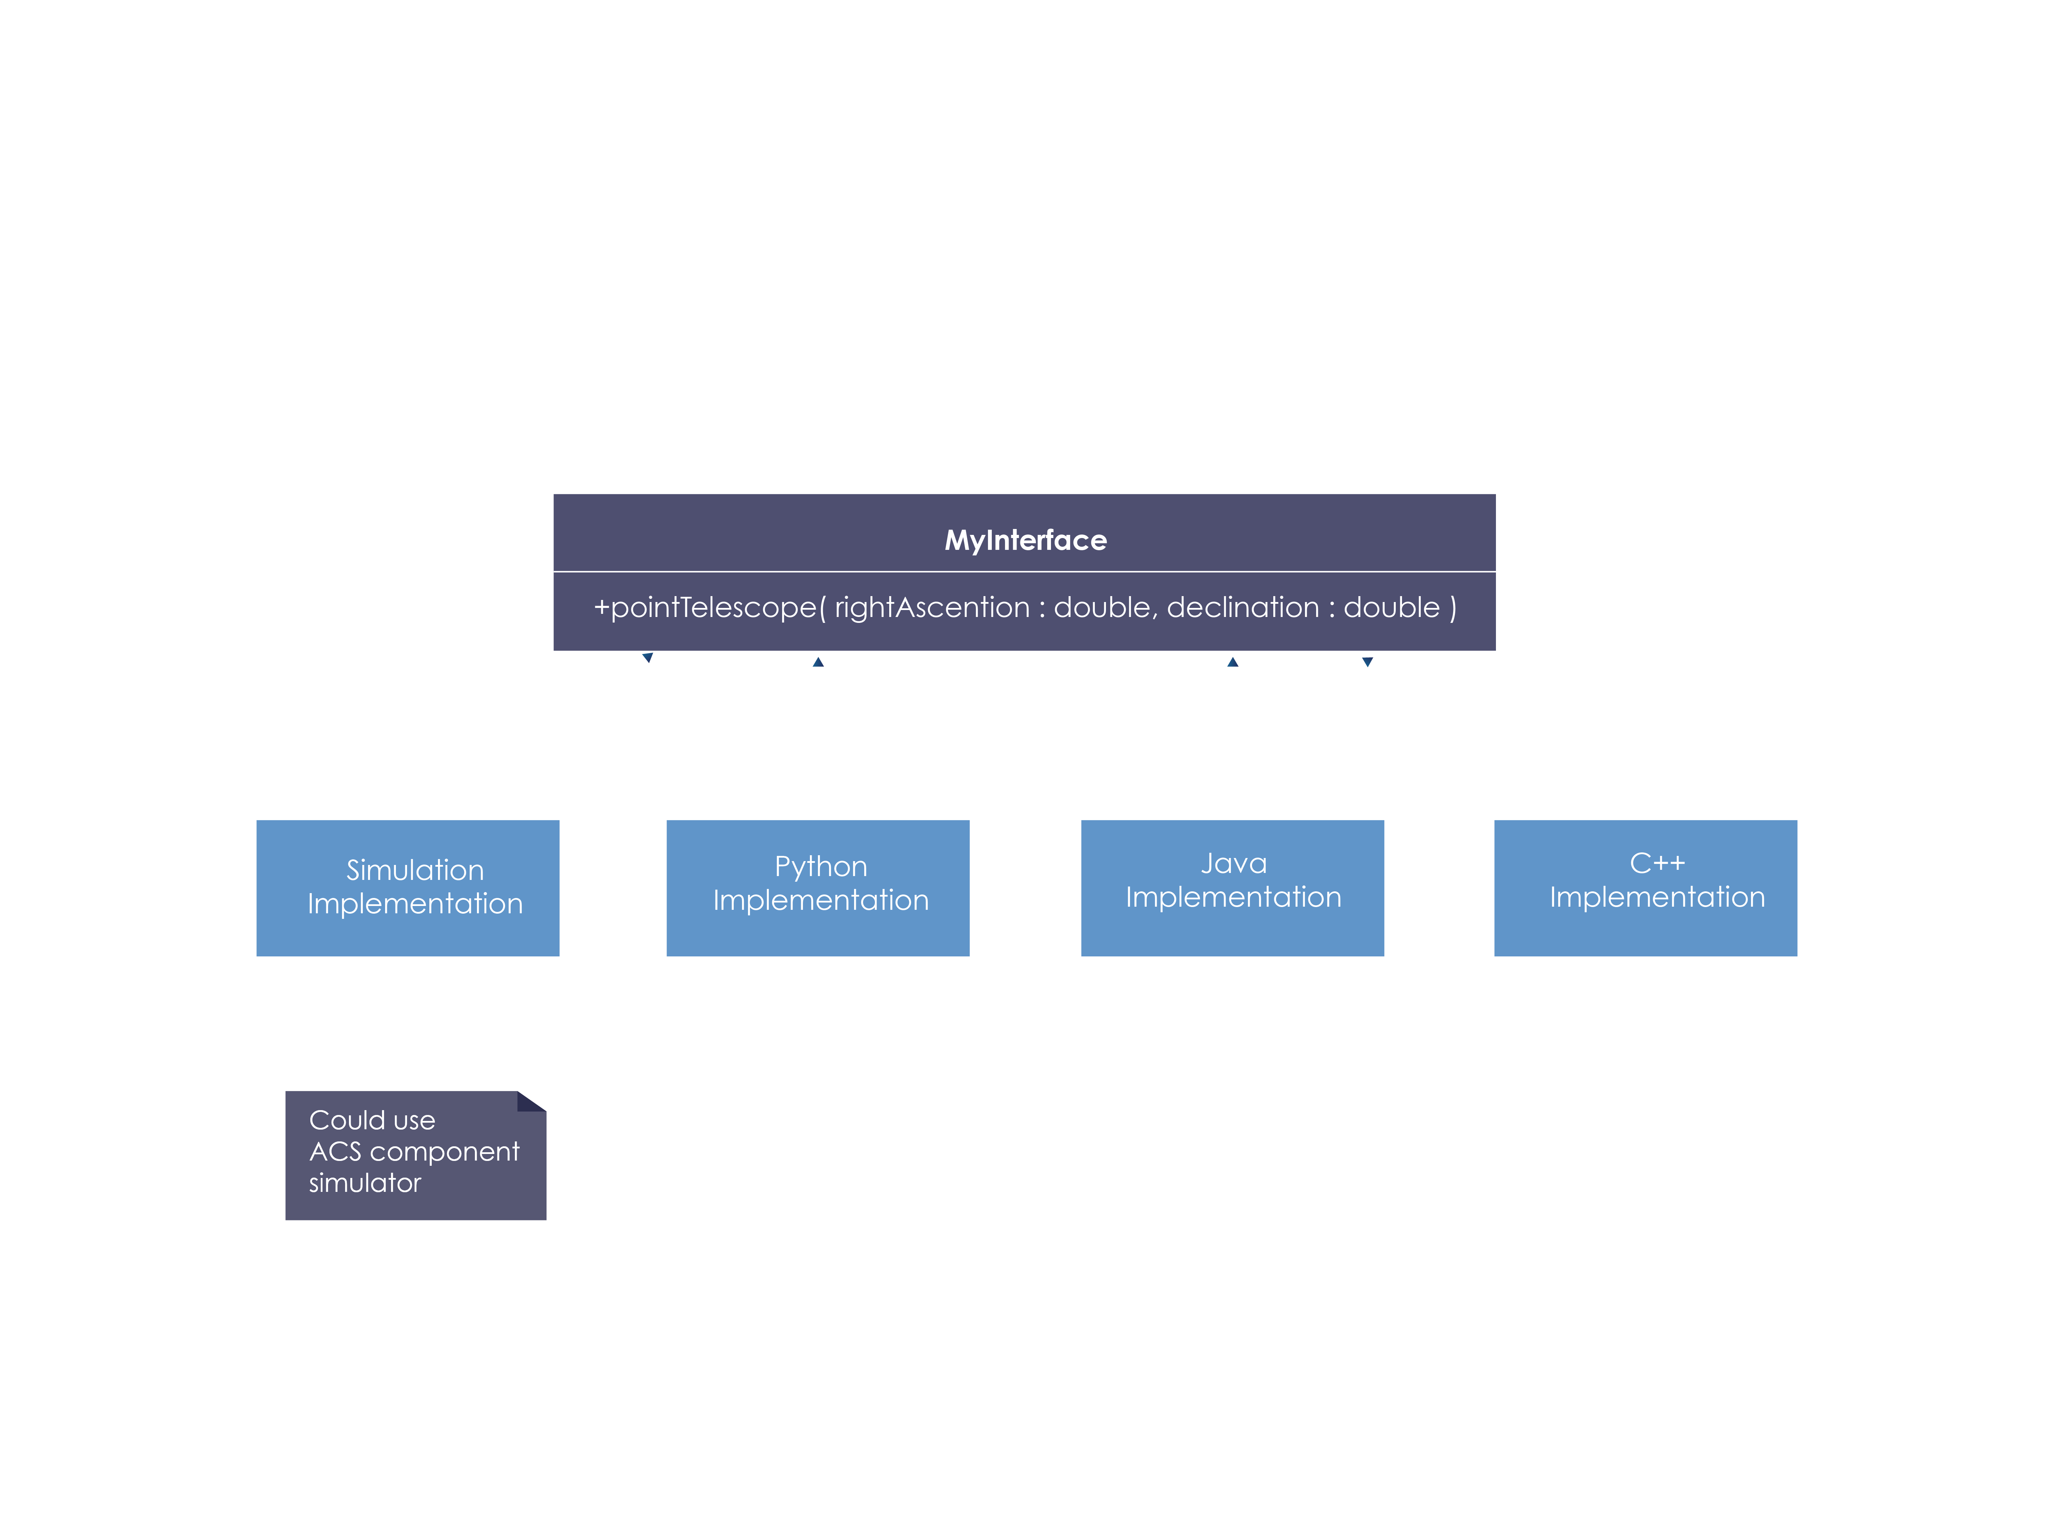
One Interface, many implementations
Notes:
Details on container location information and container startup:
for the system to work, it is good enough to start containers by hand on any machine. They dynamically add themselves. This is only done for tests though.
In the real ALMA, the central starter application “Executive” starts containers on various machines, before any application software gets run. Exec maintains a configuration file that assigns containers to machines.
Soon the CDB will optionally include container-machine location data.
Services:
Error propagation across processes
Logging
Alarm
Event-based notification
Bulk data transfer
Other services can be plugged into the container framework if necessary (e.g. security)

Slide 27
Interface Definition Language (IDL)
CORBA and DDS both use the same formal interface definition language: IDL
IDL forms a ‘contract’ between client and servant or publisher and
subscriber
IDL reconciles diverse object models and programming languages
Imposes the same object model on all supported languages
Programming language independent means of describing data types and object interfaces
purely descriptive - no procedural components
provides abstraction from implementation
allows multiple language bindings to be defined
A way to integrate and share objects from different object models and languages
Notes:
CORBA specifies an Interface Definition Language. IDL is an ISO standard. Actually IDL is a general interface definition language used to specify interfaces also in environments that are not using CORBA at all.
Also DDS uses IDL as the specification language for the data types (called Topics) exchanged between publishers and subscribers.
This allows a smooth coexistence of CORBA and DDS to satisfy different requirements in the same system.
Rather than inventing a new language, it is a good choice to take an already existing one that has been in use for long time.
Part of the IDL specification is also a formal mapping from IDL to any supported programming language and the other way around. There are for example mappings from and to IDL for C, C++, Java, Python, TCL and many others.
This has the great advantage of reconciling different object models and programming languages allowing them to easily inter operate.
But on the other hand forces some compromises, in particular since some of the supported languages are not object oriented.
For example:
IDL supports interface inheritance (actually, multiple inheritance) but does not allow overloading, i.e. it does not allow multiple operations with the same name but a different signature. This would not be possible to implement in an easy and intuitive way in the C mapping.
IDL supports Exceptions, but not inheritance between exceptions
IDL has also important limitations in the specification of interfaces. IDL 3 addresses a number of these limitations.
For example:
IDL 2 only specifies the definition of published interfaces. To build a model of the interactions between objects it is useful to be able to specify also:
Required interfaces
Published event
Subscribed events
The specification of an interface consists only in the signatures of the methods, but not in the pre/post conditions. For example, it is not possible to specify ranges for parameters

Slide 28
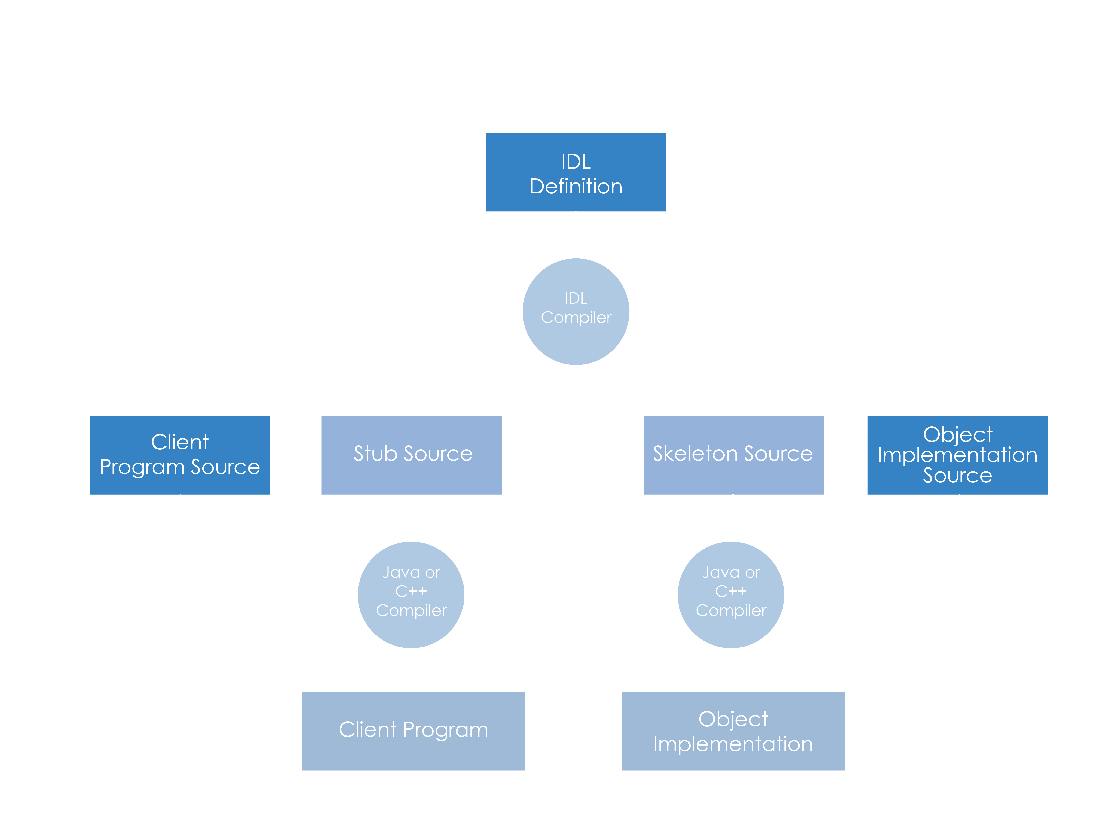
Development Process
Notes:
When thinking about the IDL language definition, it is important to think that IDL is a language to define INTERFACES and not IMPLEMENTATION. For example there is no point in implementing such things as:
private operations or attributes because what is private in Java or C++ is “hidden inside the implementation” and, therefore has no place in the interface
operation overriding, i.e. redefining the same operation in a sub-class with a different behaviour, since the behaviour is again domain of the implementation.
It is quite common to confuse interface and implementation aspects.
This diagram shows how an IDL definition is used in the code development process in CORBA.
The IDL file is processed by one or more IDL compilers
Each IDL compiler can produce:
Stub code The stub code is the code that a client has to call to invoke a remote CORBA object.
Skeleton code The skeleton is the code that has to be used as the bases for the implementation of the servant.
So the development process can be seen through the following steps:
The IDL interface is defined in agreement between the developers of servants and clients and published as the contract between them.
The developer of the servant:
chooses an implementation language (for example C++)
selects a CORBA implementation for that language (for example TAO)
runs the agreed IDL through the IDL compiler and obtains a Skeleton. In the C++ case, this is an abstract C++ class mapping all operations and attributes of the class into abstract methods
subclasses the skeleton and implements all abstract methods
The developer of the client:
chooses an implementation language (for example Python)
select a CORBA implementation for that language (for example OmniORB)
runs the agreed IDL through the IDL compiler and obtains a Stub. In the Python case, this is a python class mapping all operations and attributes of the class
simply calls the stub methods.

Slide 29
Questions?
Acknowledgements
ACS presentations were originally developed by the ALMA Common Software development team and has been used in many instances of training courses since 2004. Main contributors are (listed in alphabetical order): Jorge Avarias, Alessandro Caproni, Gianluca Chiozzi, Jorge Ibsen, Thomas Jürgens, Matias Mora, Joseph Schwarz, Heiko Sommer.
The Atacama Large Millimeter/submillimeter Array (ALMA), an international astronomy facility, is a partnership of Europe, North America and East Asia in cooperation with the Republic of Chile. ALMA is funded in Europe by the European Organization for Astronomical Research in the Southern Hemisphere (ESO), in North America by the U.S. National Science Foundation (NSF) in cooperation with the National Research Council of Canada (NRC) and the National Science Council of Taiwan (NSC) and in East Asia by the National Institutes of Natural Sciences (NINS) of Japan in cooperation with the Academia Sinica (AS) in Taiwan. ALMA construction and operations are led on behalf of Europe by ESO, on behalf of North America by the National Radio Astronomy Observatory (NRAO), which is managed by Associated Universities, Inc. (AUI) and on behalf of East Asia by the National Astronomical Observatory of Japan (NAOJ). The Joint ALMA Observatory (JAO) provides the unified leadership and management of the construction, commissioning and operation of ALMA.

