Slide 1
ALMA Common Software Basic Track
Component/Container Model and Lifecycle Management

Slide 2
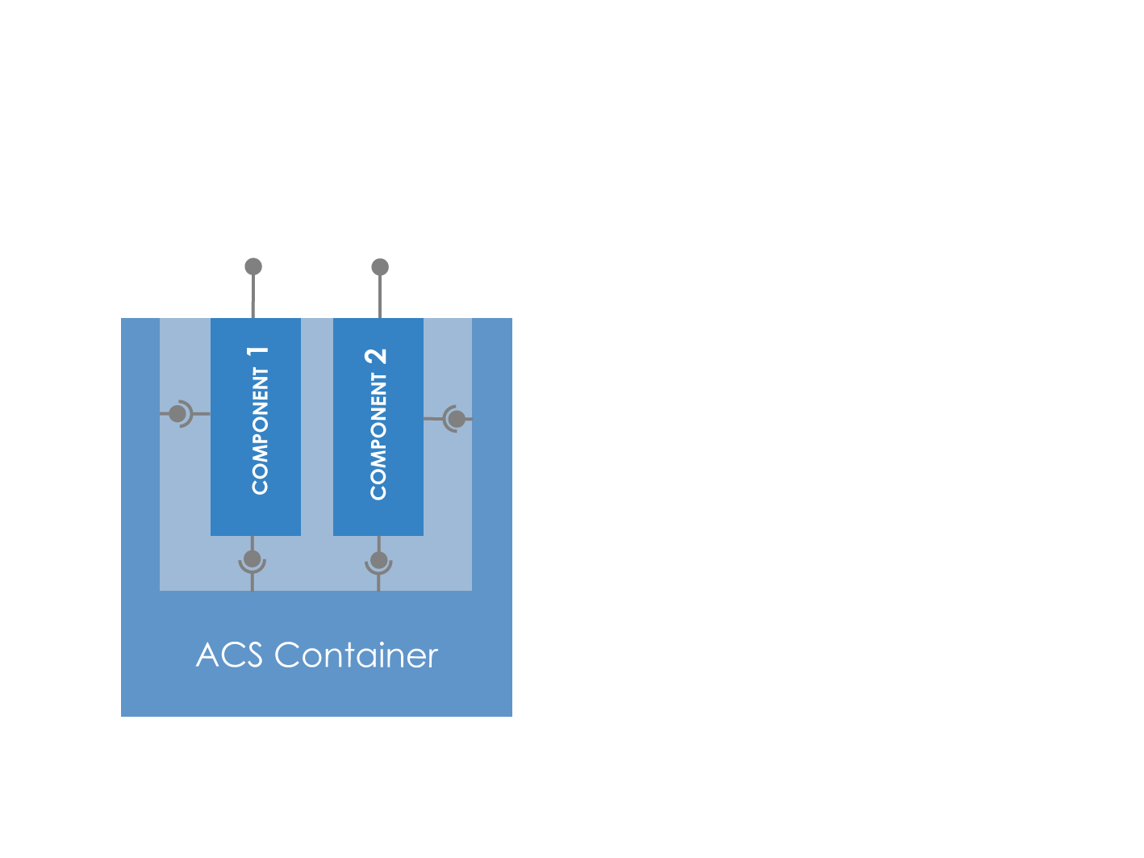
Container/Component
Components provide specific functionality to the system. They are started and stopped by the container, whom offers the component services (some of which may not directly visible to the component itself)
The container only cares about the lifecycle interface of the components deployed on it

Slide 3
Component
Deployable unit of ALMA software
Same concept from device level to data flow application
1…many classes per component
1…many components per subsystem
Functional interface defined in CORBA IDL
Deployed within a Container
Well-defined lifecycle (initialization, finalization)
Accessible as a plain CORBA object if required
Focus on functionality with little overhead for remote communication and deployment
Concept promotes modular and decoupled application code
Notes:
IDL definition is programming language neutral
plain CORBA access allows using generic tools, e.g. the RSI IDL bridge for data display mentioned by the HPT project
Deployment of a component instance in a particular container can be done
statically at deployment time if the instance is known beforehand
dynamically at runtime
Modular design with well-defined interfaces facilitates simulations and testing, and to some extent also reuse and refactoring.

Slide 4
Container
Centrally handles technical concerns and hides them from application developers
Deployment, Start-up
Selection and configuration of various ORBs; here CORBA alone is much too complicated.
Selection of CORBA Services, integration with ACS Services (error, logging, configuration, …)
Convenient access to other components and resources
New technical aspects can be integrated in the future, without modifying the application software
Notes:
Developing distributed code is intrinsically more difficult, even if a middleware less powerful than CORBA would be used. The container can shield off some of this complexity.
Technical aspects shielded by container could be
multi-level call tracing from user action to remote services
security checks
support for other communication mechanisms (e.g. web services)

Slide 5
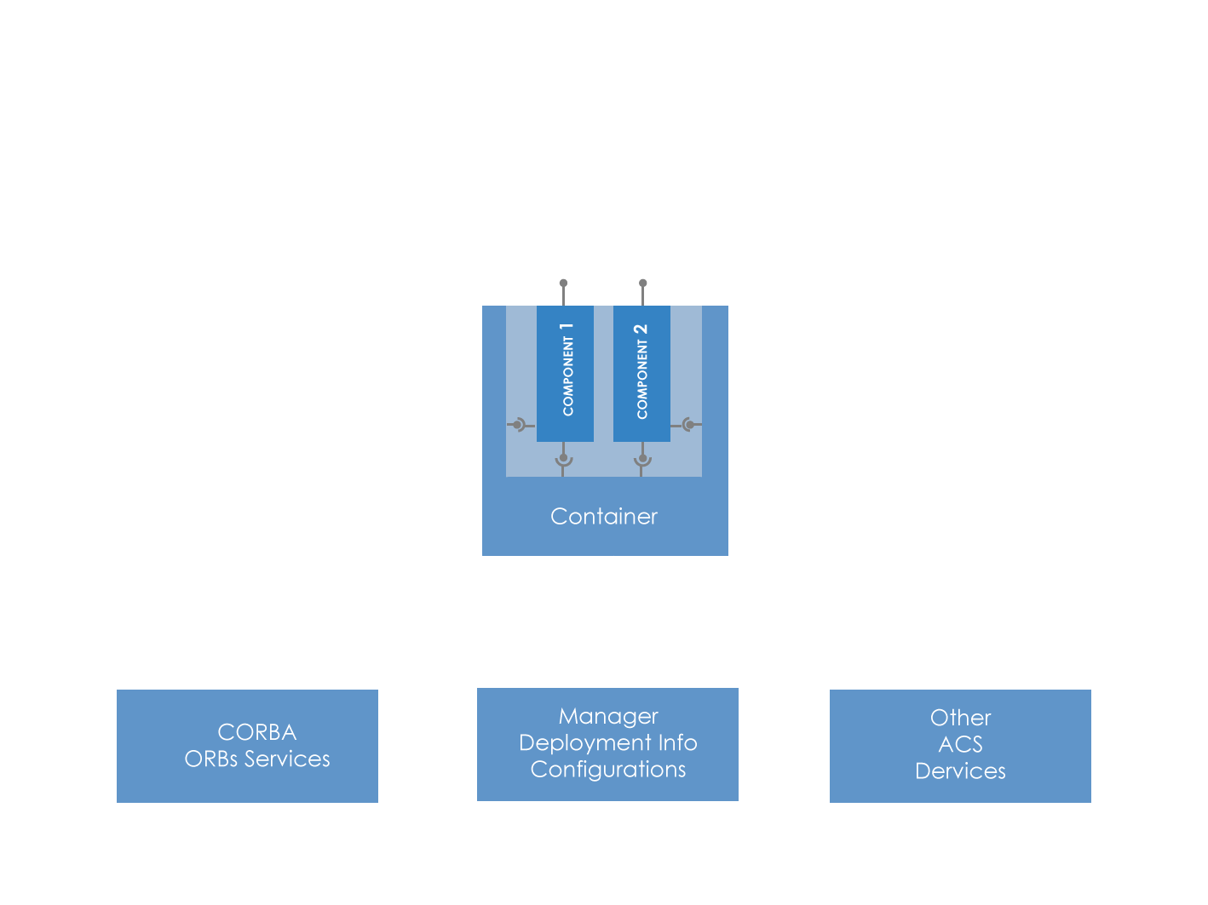
Container/Component Interfaces
Functional Interface: observe, move, …
Container Service Interface: getName getLogger getComponent
Lifecycle Interface: init, run, shutdown

Slide 6
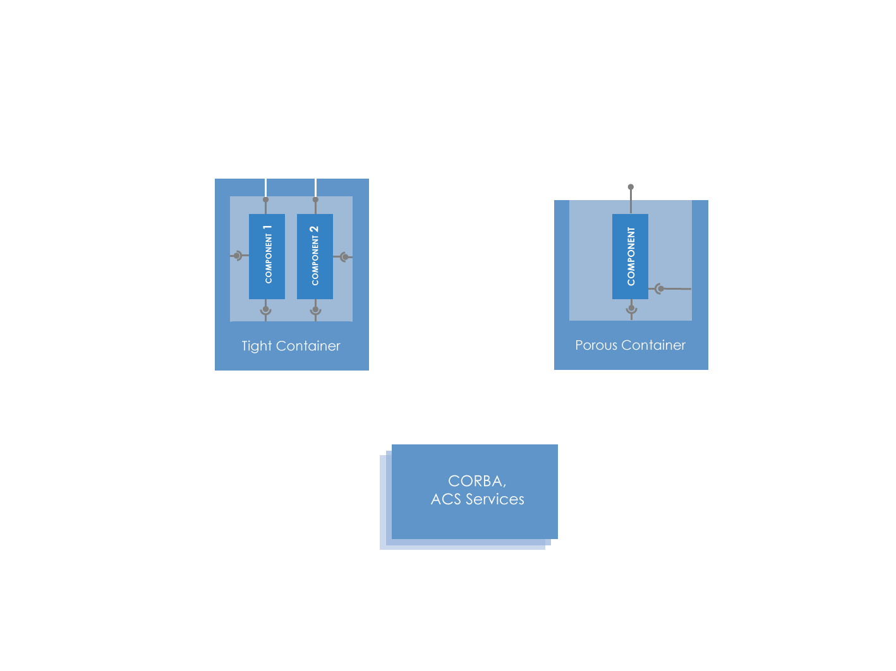
Tight versus Porous Containers
Functional interface is intercepted by the container for logging and/or exception handling, security, …
Container manages lifecycle and offers services, but exposes the component’s functional interface directly – less overhead

Slide 7
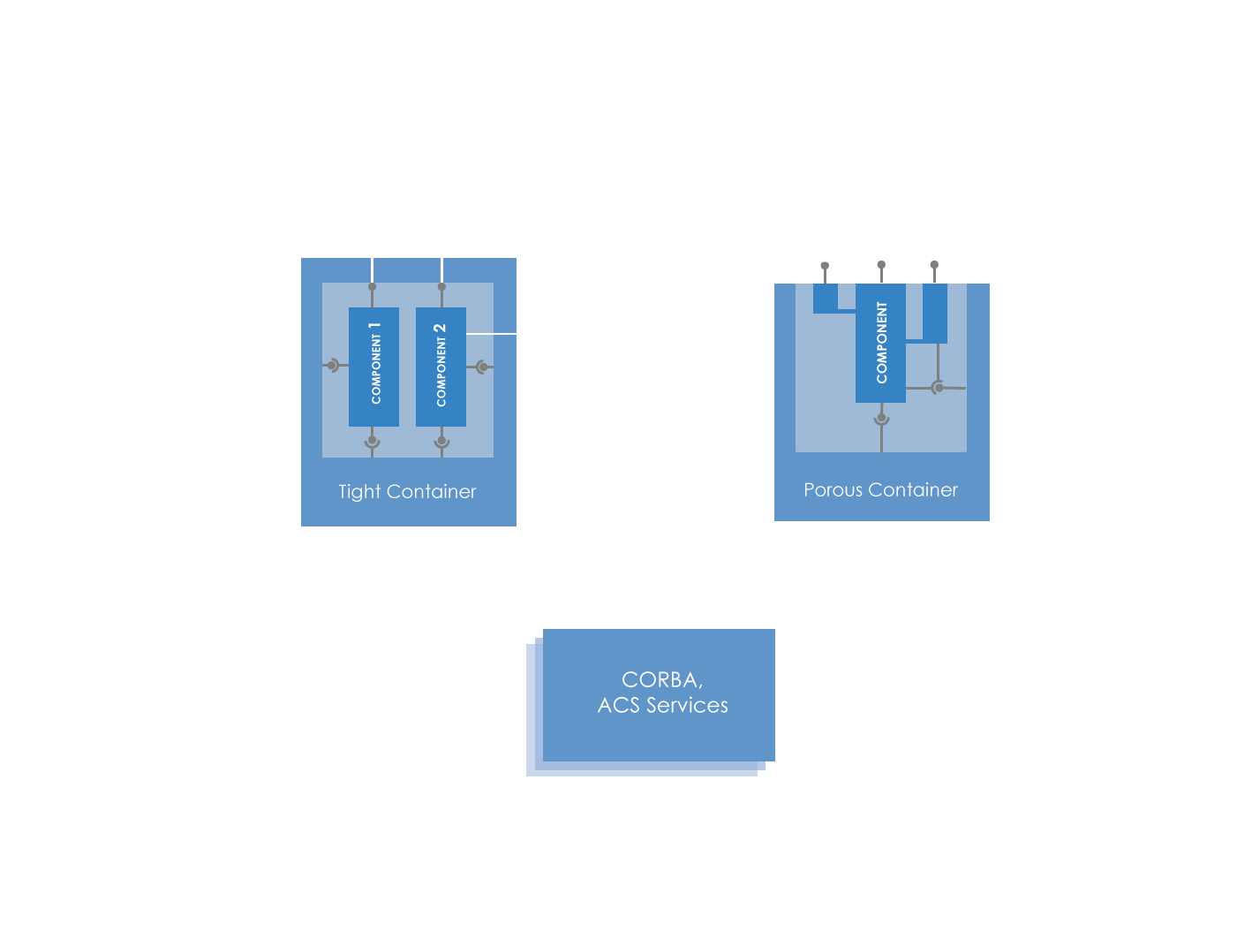
Component Offshoots
Offshoot uses same Container Services instance
Remotely visible object created by a component
Life is limited to that of the component
Offshoots are conceptually “in between” components and programming-language-specific objects
Offshoots use the same container services instance as the component

Slide 8
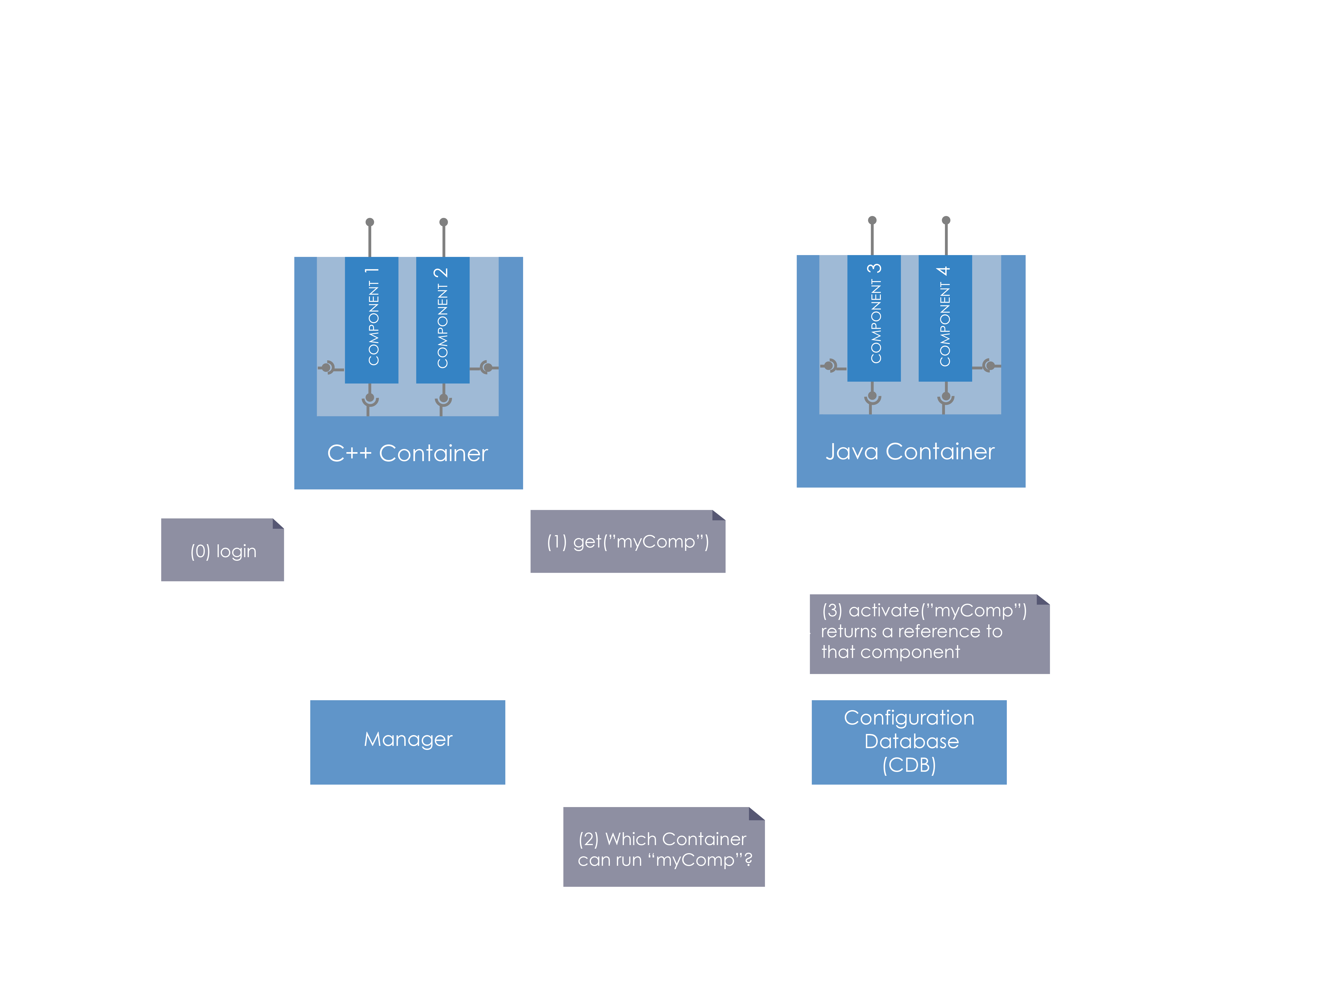
Interactions: component activation and retrieval
Notes:
As can be seen from the previous discussion, the architecture of the observatory is very distributed.
Servers and clients need to be distributed in different locations inside and outside the physical observatory where the telescope resides.
The different parts of the system (that we did not better specify yet) have different purpose and functionality and therefore have different requirements on performance and reliability.
If we take into account that parts of the system are dedicated to real time control of hardware, coordination, database management, data analysis up to the GUIs on the astronomer’s desktop, we see that this distribution involves something more than a plain Distributed System.

Slide 9
Interactions: component activation and retrieval
Manager and CDB (with deployment info) are running
Containers are logged in to the Manager with their names, f.i. “Telescope”
We assume that one component is running already…
The Component requests a reference to another Component from its Container
Container asks Manager for that other Component
Manager asks CDB which Container hosts the Component (can be the same container as before or a different one)
Manager tells Container to load the new Component
Notes:
Manager is often a system-wide singleton, but ACS also offers federated managers a manager is only unique inside a manager domain.
Manager delegates work to the CORBA Naming Services
side benefit: non-ACS aware software sees components as CORBA objects, only needed when extending the normal ACS ways.
All containers must implement an IDL-defined interfaces that manager uses when talking to them.

Slide 10
Interactions: component activation and retrieval
Container returns reference to new Component to the Manager
Manager returns reference to new Component to first Container
Now the Container gives its Component the reference to the other Component
NOTE: It is not allowed to pass directly Component references between Components as parameters of interfaces. Components must be passed around always by name and a request to the Manager must be issued using the Container Services getComponent() interface.
Notes:
Manager is often a system-wide singleton, but ACS also offers federated managers a manager is only unique inside a manager domain.
Manager delegates work to the CORBA Naming Services
side benefit: non-ACS aware software sees components as CORBA objects, only needed when extending the normal ACS ways.
All containers must implement an IDL-defined interfaces that manager uses when talking to them.

Slide 11
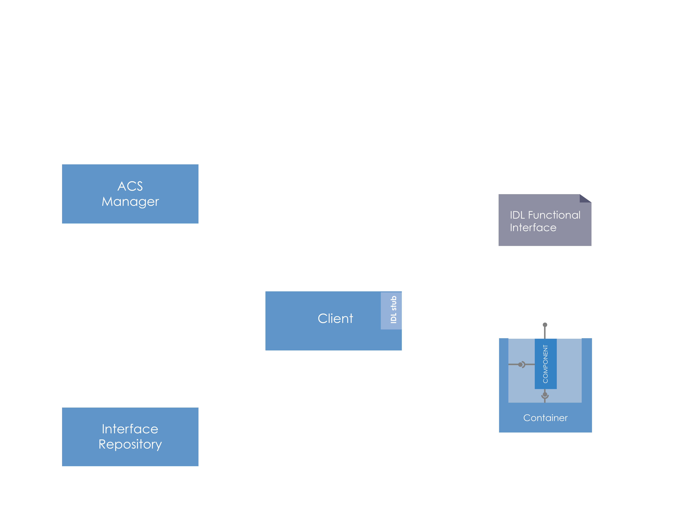
Interactions: client’s view
Notes:
As can be seen from the previous discussion, the architecture of the observatory is very distributed.
Servers and clients need to be distributed in different locations inside and outside the physical observatory where the telescope resides.
The different parts of the system (that we did not better specify yet) have different purpose and functionality and therefore have different requirements on performance and reliability.
If we take into account that parts of the system are dedicated to real time control of hardware, coordination, database management, data analysis up to the GUIs on the astronomer’s desktop, we see that this distribution involves something more than a plain Distributed System.

Slide 12
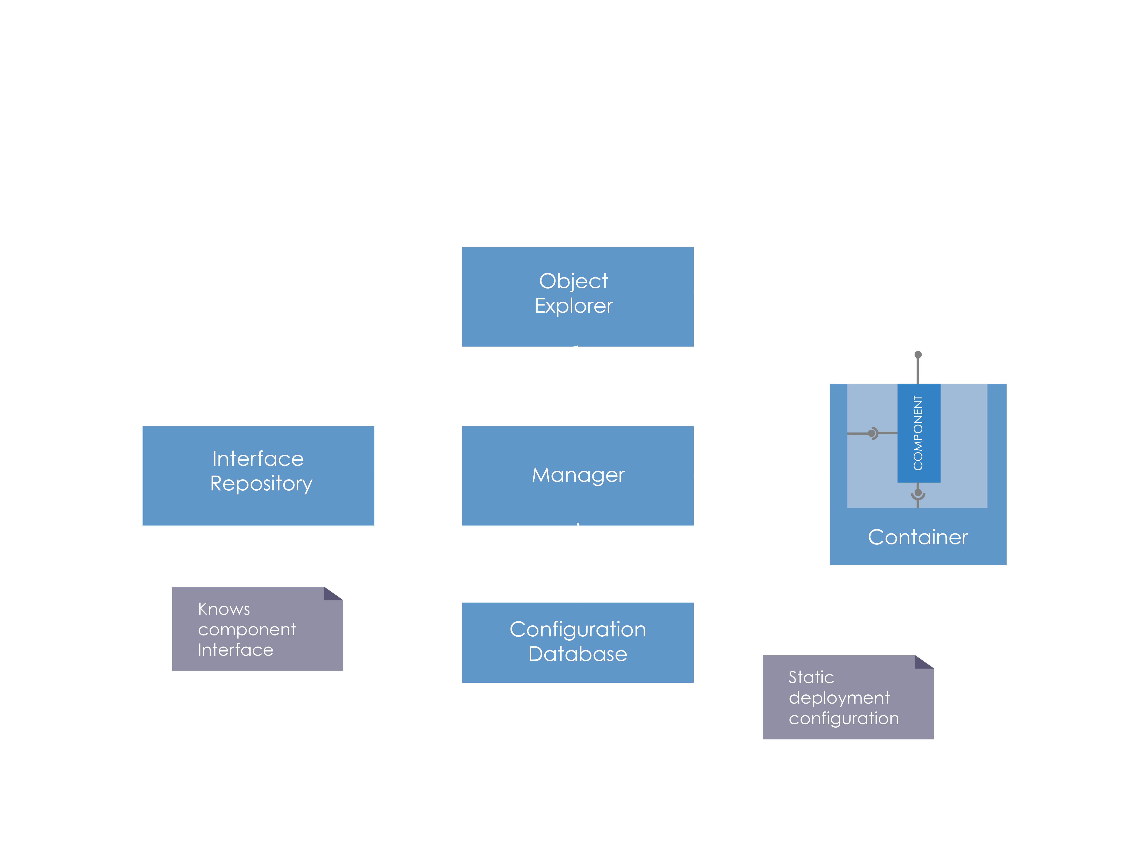
Interactions: client’s view
Notes:
As can be seen from the previous discussion, the architecture of the observatory is very distributed.
Servers and clients need to be distributed in different locations inside and outside the physical observatory where the telescope resides.
The different parts of the system (that we did not better specify yet) have different purpose and functionality and therefore have different requirements on performance and reliability.
If we take into account that parts of the system are dedicated to real time control of hardware, coordination, database management, data analysis up to the GUIs on the astronomer’s desktop, we see that this distribution involves something more than a plain Distributed System.

Slide 13
Questions?
Acknowledgements
ACS presentations were originally developed by the ALMA Common Software development team and has been used in many instances of training courses since 2004. Main contributors are (listed in alphabetical order): Jorge Avarias, Alessandro Caproni, Gianluca Chiozzi, Jorge Ibsen, Thomas Jürgens, Matias Mora, Joseph Schwarz, Heiko Sommer.
The Atacama Large Millimeter/submillimeter Array (ALMA), an international astronomy facility, is a partnership of Europe, North America and East Asia in cooperation with the Republic of Chile. ALMA is funded in Europe by the European Organization for Astronomical Research in the Southern Hemisphere (ESO), in North America by the U.S. National Science Foundation (NSF) in cooperation with the National Research Council of Canada (NRC) and the National Science Council of Taiwan (NSC) and in East Asia by the National Institutes of Natural Sciences (NINS) of Japan in cooperation with the Academia Sinica (AS) in Taiwan. ALMA construction and operations are led on behalf of Europe by ESO, on behalf of North America by the National Radio Astronomy Observatory (NRAO), which is managed by Associated Universities, Inc. (AUI) and on behalf of East Asia by the National Astronomical Observatory of Japan (NAOJ). The Joint ALMA Observatory (JAO) provides the unified leadership and management of the construction, commissioning and operation of ALMA.

